Slide 1

The Rise and Fall (and Potential Rise) of BSNL
Bharat Sanchar Nigam Limited (BSNL), a company that once dominated the Indian telecommunications landscape but faced a period of decline. We'll explore the factors that contributed to its rise and fall, analyze its current position, and discuss its potential for a comeback in the ever-evolving telecoms market.
by Pandurang Rayfalwar

Slide 2
The Early Days: A Dominant Force
A Government Initiative
Market Leadership
Profitability
BSNL was established in 2000 as a public sector undertaking (PSU) under the Indian government, with the mandate to provide universal telecommunication services across the country.
BSNL quickly gained a significant market share, particularly in rural areas, where it provided essential connectivity to a large population previously without access to telecommunications.
The company consistently reported profits from 2001 to 2008, demonstrating its initial success in establishing a strong foothold in the telecoms industry.

Slide 3
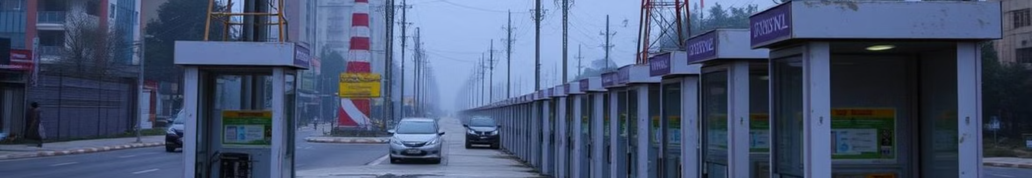
The Downfall: A Series of Misfortunes
1
Corruption Scandals
2
Inefficiency and Red Tape
BSNL's involvement in high-profile corruption cases eroded public trust, damaging its reputation and weakening its position in the market.
Bureaucratic hurdles and outdated infrastructure hindered BSNL's growth, making it difficult for the company to adapt to the changing technological landscape.
3
Technological Stagnation
4
Aggressive Competition
BSNL lagged behind private players in adopting new technologies like 4G and 5G, leaving it at a competitive disadvantage.
The emergence of aggressive private players like Reliance Jio and Airtel, with their innovative services and attractive pricing strategies, put immense pressure on BSNL.

Slide 4
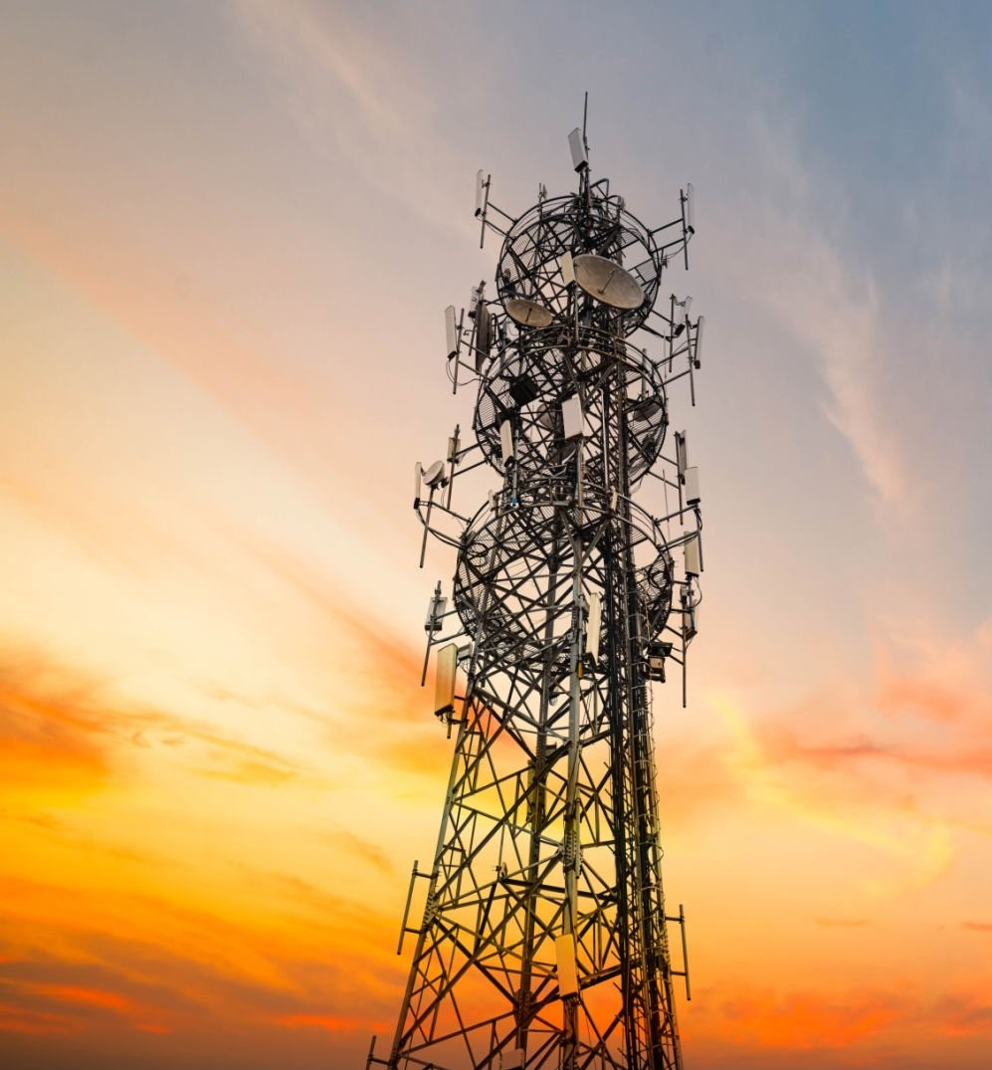
The Fight for Survival
Government Support
Infrastructure Upgrades
To revive BSNL, the Indian government has provided substantial financial support to help the company invest in infrastructure upgrades and technology development.
BSNL is actively modernizing its network infrastructure by expanding its fiber optic network and upgrading its core technology to enhance network capacity and quality.
Efficiency Measures
Focus on Rural Connectivity
The company has implemented workforce reduction measures and streamlined its operations to improve efficiency and reduce costs.
BSNL is leveraging its existing network to provide services in underserved rural areas, aiming to expand its customer base and strengthen its position in the market.

Slide 5
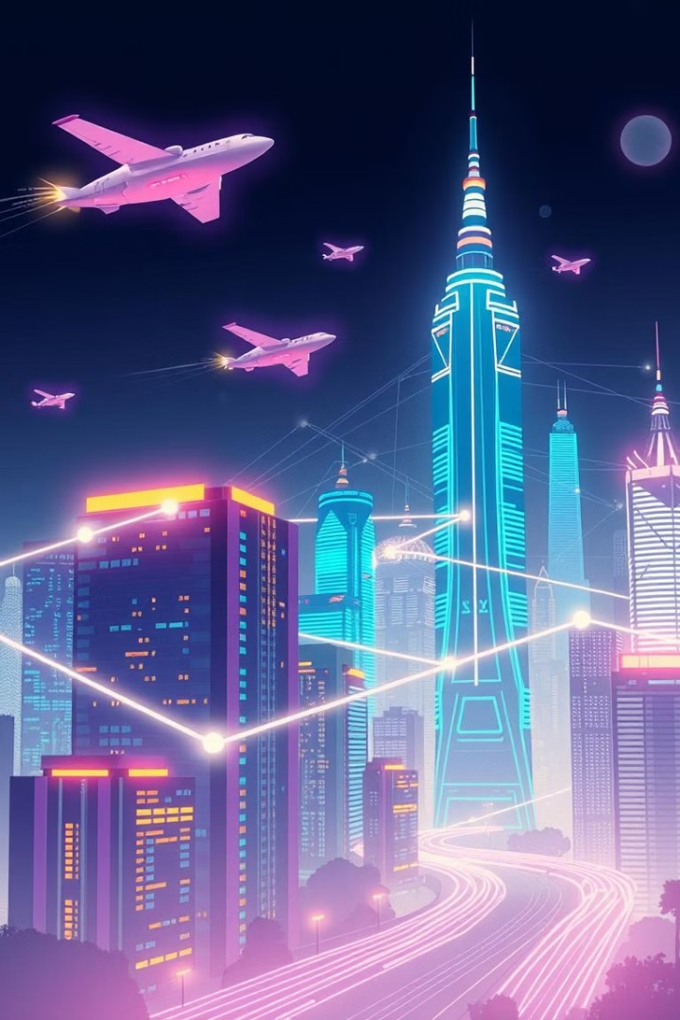




Potential for a Comeback
Government Backing
Technological Advancements
BSNL enjoys strong support from the Indian government, which is committed to its revival and plays a significant role in its strategic direction.
BSNL's adoption of 5G technology will enable it to provide high-speed internet access, a crucial factor in attracting new customers and competing effectively.
Rural Connectivity
Customer Loyalty
BSNL holds a unique advantage in serving rural markets due to its extensive network presence and commitment to bridging the digital divide.
BSNL retains a loyal customer base, particularly in rural areas, where it enjoys a strong brand reputation and customer trust.
According to recent news Ratan Tata's TCS is partnering with BSNL to modernize India's telecom infrastructure. This includes setting up data centers and deploying 4G/5G networks, especially in rural areas. This collaboration aims to bridge the digital divide and accelerate India's digital transformation.

Slide 6

Lessons Learned
Innovation
BSNL's experience highlights the importance of continuous innovation and adaptability in a dynamic market, as failure to embrace technological advancements can lead to stagnation and decline.
Government Intervention
Government support can be a double-edged sword, providing crucial resources while potentially hindering innovation and flexibility.
1
2
3
4
Corruption
Customer Satisfaction
The company's struggles emphasize the damaging consequences of corruption, which can severely erode public trust, undermine financial stability, and hinder growth.
Prioritizing customer needs, providing excellent service, and fostering customer loyalty are essential for long-term success in any industry.

Slide 7



Conclusion: A Comeback Story?
Revival
With the right strategies and government support, BSNL has the potential to stage a comeback and reclaim its position as a major player in the Indian telecommunications market.
1
Growth
2
The company can capitalize on its strengths, such as its rural network presence, customer loyalty, and government support, to drive future growth and profitability.
Challenges
3
BSNL must overcome its legacy of inefficiency and corruption, enhance its technological capabilities, and build a culture of innovation to compete effectively.

Slide 8
SWOT Analysis: A Deeper Dive
Strengths
1
BSNL's extensive network infrastructure, strong rural presence, government support, and loyal customer base are key strengths that can fuel its comeback.
Weaknesses
2
BSNL's challenges include bureaucratic inefficiencies, technological backwardness, and legacy issues related to corruption and outdated infrastructure.
Opportunities
3
Opportunities for BSNL include leveraging the growth of the digital economy, expanding its 4G and 5G services, and targeting new customer segments.
Threats
4
BSNL faces threats from the increasing competition from private players, the rapid pace of technological innovation, and the potential for further regulatory changes.

Slide 9

Next Steps: A Vision for the Future
1
2
Innovation
Efficiency
Invest heavily in research and development to stay at the forefront of technological advancements and create innovative products and services.
Streamline operations, reduce bureaucracy, and implement cost-cutting measures to improve efficiency and profitability.
3
4
Customer Focus
Digital Inclusion
Prioritize customer satisfaction by offering high-quality services, competitive pricing, and exceptional customer support.
Leverage its network to bridge the digital divide, expand connectivity to underserved areas, and empower communities through technology.

Slide 10
Thank You …
Pandurang Rayfalwar
pandurangrayfalwar@gmail.com

